Slide 1
Introductions.
Who we are:
Katherine Buchanan – Principal Podiatrist
Ciaran McGinley – Specialist Podiatrist

Slide 2
Please download and install the Slido app on all computers you use
Podiatry - what comes to mind?
ⓘ Start presenting to display the poll results on this slide.

Slide 3


Slide 4


Slide 5


Slide 6
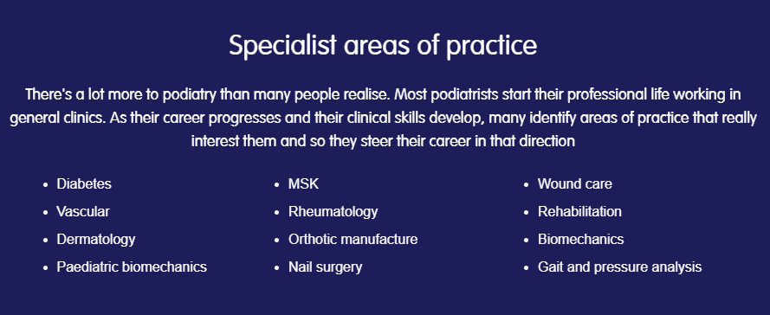

Slide 7
Standard entry conditions
A level
BBB to include one from:
Mathematics, Physics, Chemistry, Biology, CCEA Single Award Life & Health Sciences (first taught September 2016), Double Award Life & Health Sciences (grade BB) or Double Award Applied Science (grade BB).
GCSE
GCSE pass at Grade C/4 or above in English Language, additionally GCSE Mathematics Grade C/4.
.

Slide 8
University of Brighton
Podiatry BSc (Hons) 3 years full time
Cardiff Metropolitan University
Podiatry BSc (Hons) 3 years full time
Podiatry BSc (Hons) 4 years full time with foundation year
New College Durham
Podiatry BSc (Hons) 3 years full time
University of East London
Podiatry BSc (Hons) 3 years full time
Queen Margaret University Edinburgh
Master of Podiatry (MPod)/BSc (Hons) Podiatry – 4 years full time
University of Galway
Podiatric Medicine (BSc) - 3 years
Glasgow Caledonian University
Podiatric Medicine (BSc) – 3 years
University of Huddersfield
Podiatry BSc (Hons) 3 years full time
Podiatry BSc (Hons) 4.5 years part-time
Podiatry (Degree Apprenticeship) BSc (Hons) 3 years full time
University of Northampton
Podiatry BSc (Hons) 3 years full time
University of Plymouth
Podiatry BSc (Hons) 3 years full time
BSc (Hons) Podiatry Degree Apprenticeship – 3 years full time online course
University of Salford
Podiatry BSc (Hons) 3 years full time
University of Southampton
Podiatry BSc (Hons) 3 years full time
University of Wolverhampton
Podiatry BSc (Hons) 3 years full time
University of Ulster
Podiatry BSc (Hons) 3 years full time

Slide 9
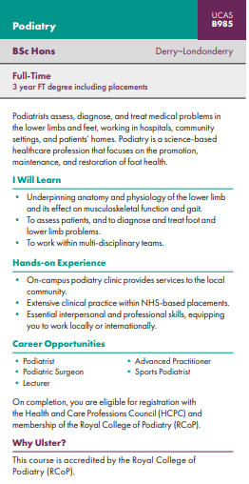

Slide 10



Slide 11
Year 1
Foundations for Interprofessional Practice
Podiatric Practice 1
This module introduces students to the structure and function of the human skin and its appendages and foundation knowledge in podiatric soft tissue pathology and therapeutics.
Patient Assessment
Teaching will focus on current approaches for interpretation of results and integration of recognising clinical signs and symptoms to assist with diagnosis.
Introductory Musculoskeletal Podiatry
This module introduces students to biomechanics of the lower limb and how to evaluate human locomotor function.
Functional Anatomy
This module will provide students with a comprehensive knowledge of the anatomy of the lower limb. Anatomy & Physiology
This module involves the systematic study of the functional anatomy and physiology of human body systems.

Slide 12
Year 2
Health Science Research
Pharmacology
Medicine and Pathology
Podiatric Practice 3
Applied MSK
Injection Therapies
This module will prepare the student in the theory and practice of LA administration and the safe and competent delivery of corticosteroid in clinical practice.
The High Risk Foot
This module is designed to explore the relationship between systemic disease and high risk status of the lower limb.

Slide 13
Year 3
Research Project
Prescription Only Medicine- Supply
Podiatric Practice 4
Podiatric Practice 5
Professional Development and Employability
Diagnostic Imaging and Surgery
This module is designed to explore the various diagnostic modalities used to image the foot and lower limb
Extended MSK

Slide 14
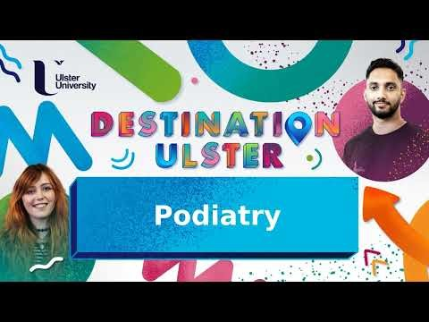

Slide 15


Slide 16
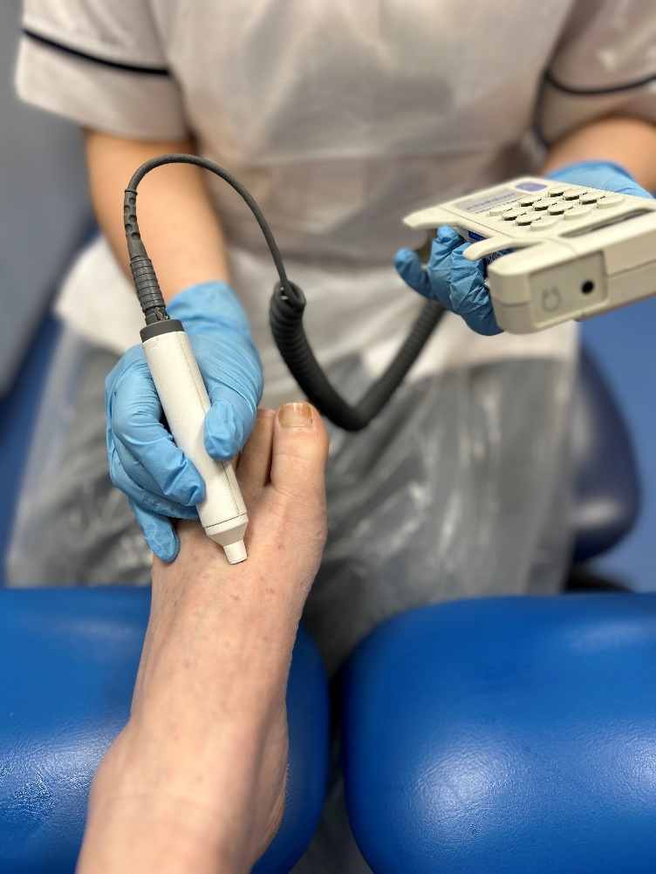
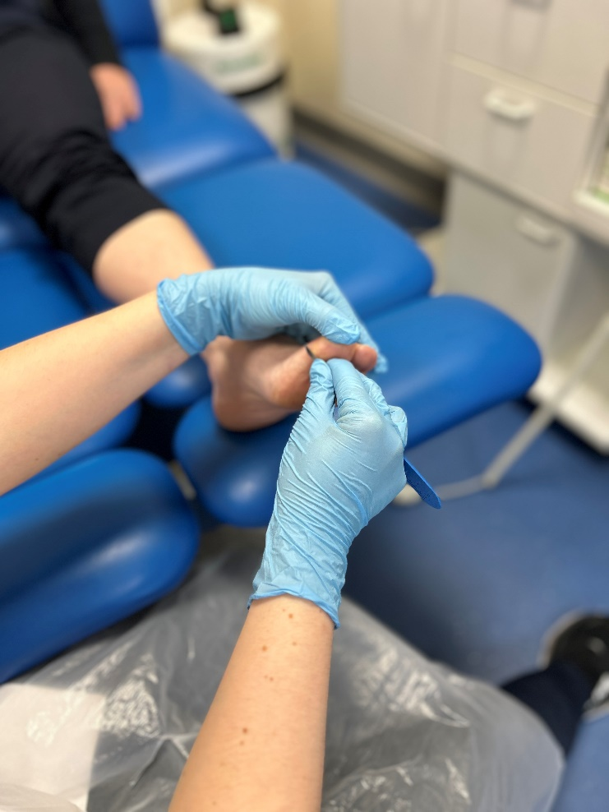
What do Podiatrists do every day!

Slide 17
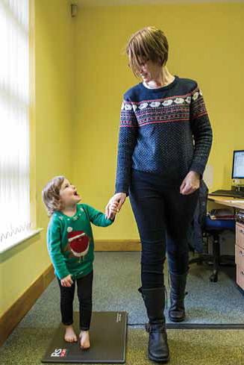
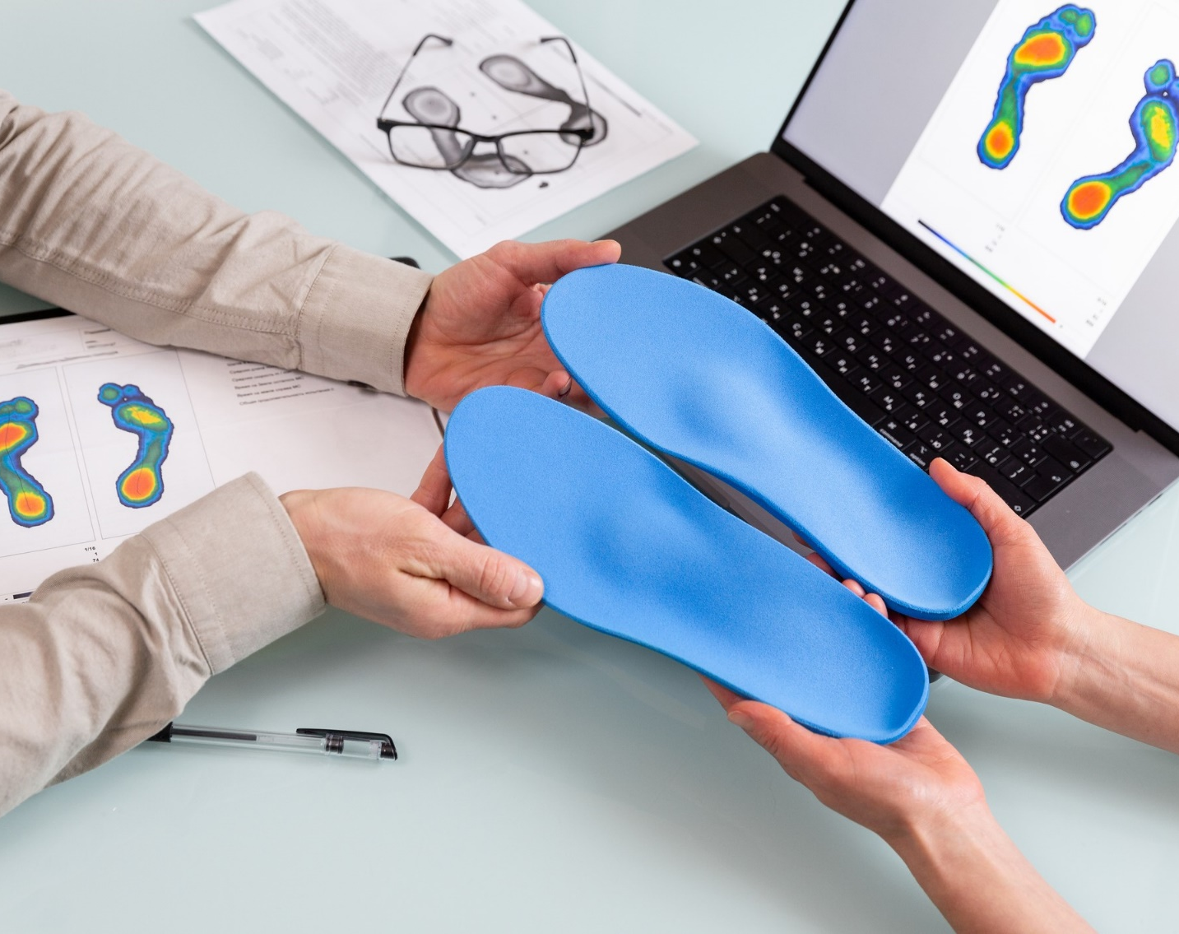

Slide 18
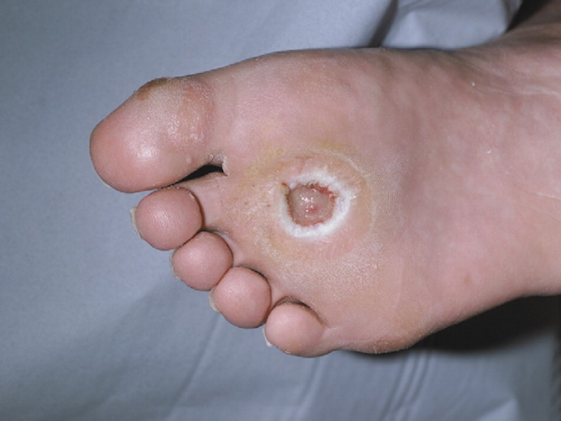
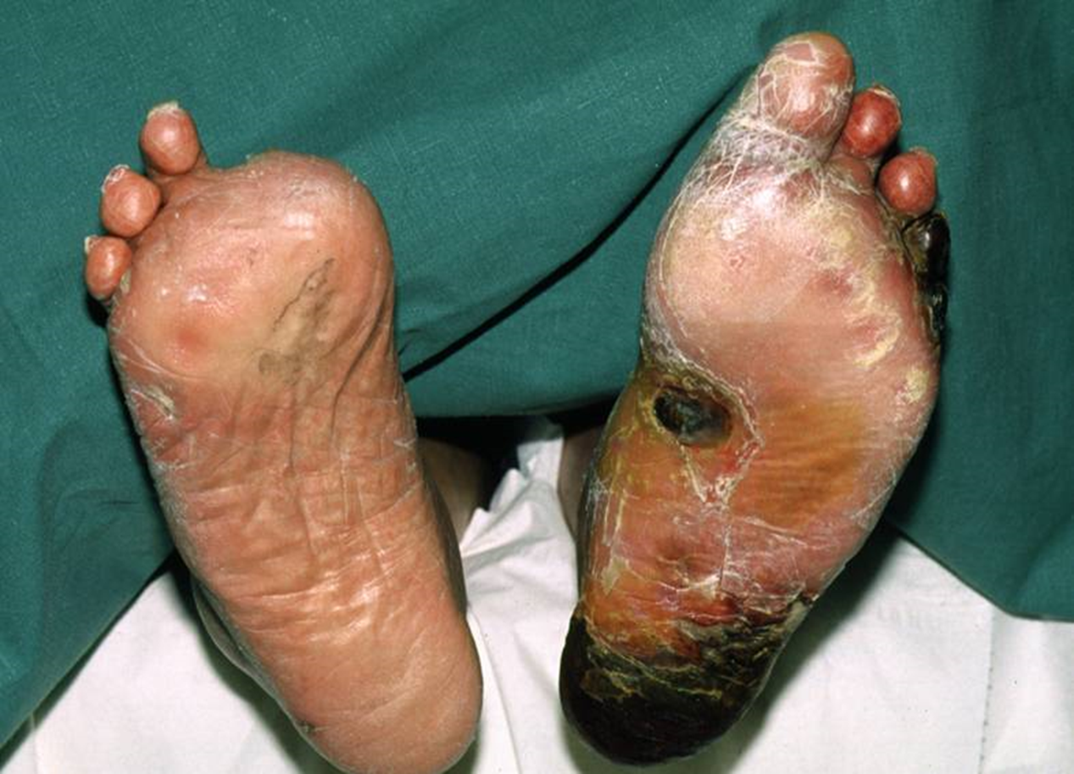

Slide 19

Even Peter from Family Guy wanted to be a Podiatrist

Slide 20


Slide 21


