Slide 1
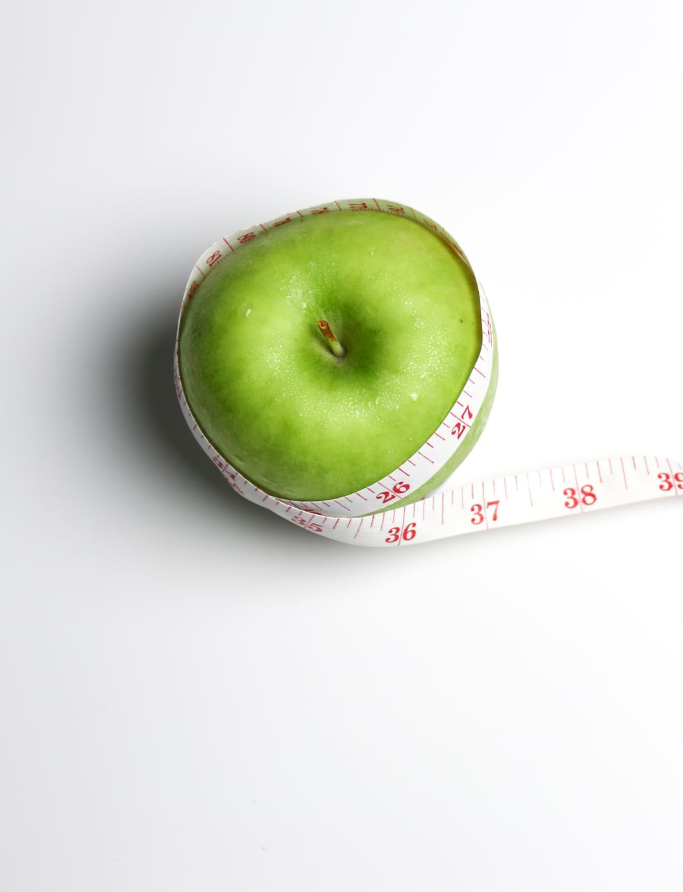
Dietetics Workshop Day

Slide 2
What Is A Dietitian
Qualified health professionals that assess, diagnose and treat diet and nutrition related problems
Work with individuals and at a wider public health level
Use up to date public health information and scientific research on food, health and disease
Translate scientific information relating to food and health into health messages and terms everyone can understand

Slide 3
What Is A Dietitian
We are statutory regulated by the Health & Care Professionals Council – state registered
Governed by an ethical code
Work to the highest standard
Career progressions through different Bands i.e band 5, 6, 7 & 8

Slide 4
Role of a Dietitian
https://youtu.be/4RmLhe72Htc

Slide 5
Where Do Dietitian`s Work?
Hospital
Community
Food
Industry
Pharmaceutical
industry
Media
Freelance
Sports Nutrition
Education
Research

Slide 6

What Does A
Dietitian Actually Do?
Clinical:
  Work as part of a team caring for people in hospital or community
Health promotion:
  Work to promote good health and prevent disease
  Food for Thought: How Dietitians are Supporting Northern Ireland to Adopt Healthier Behaviours - YouTube

Slide 7
What Does A
Dietitian Actually Do?
Obesity
Diabetes
Coeliac disease
Cancer
Critically ill
Malnutrition
Inflammatory bowel disease
Renal disease
Nutrition support
Allergies/intolerances
Texture modification

Slide 8
What Does A
Dietitian Actually Do?
Work alongside infants, young children, adolescents, young adults, older adults, older people
Other
  health care professionals
  Research colleagues
  Pharmaceutical colleagues
List is endless, depends upon the job

Slide 9
Community
Community dietitians are involved in health promotion, clinical work or a mixture of both
Travelling required
Independent workers
Variation in clients
Dependent upon job location
GP, practice nurses, health visitors, school nurses
Schools
Sure start
Voluntary group
Learning disability, mental health hospitals
Public health teams
Local authorities

Slide 10
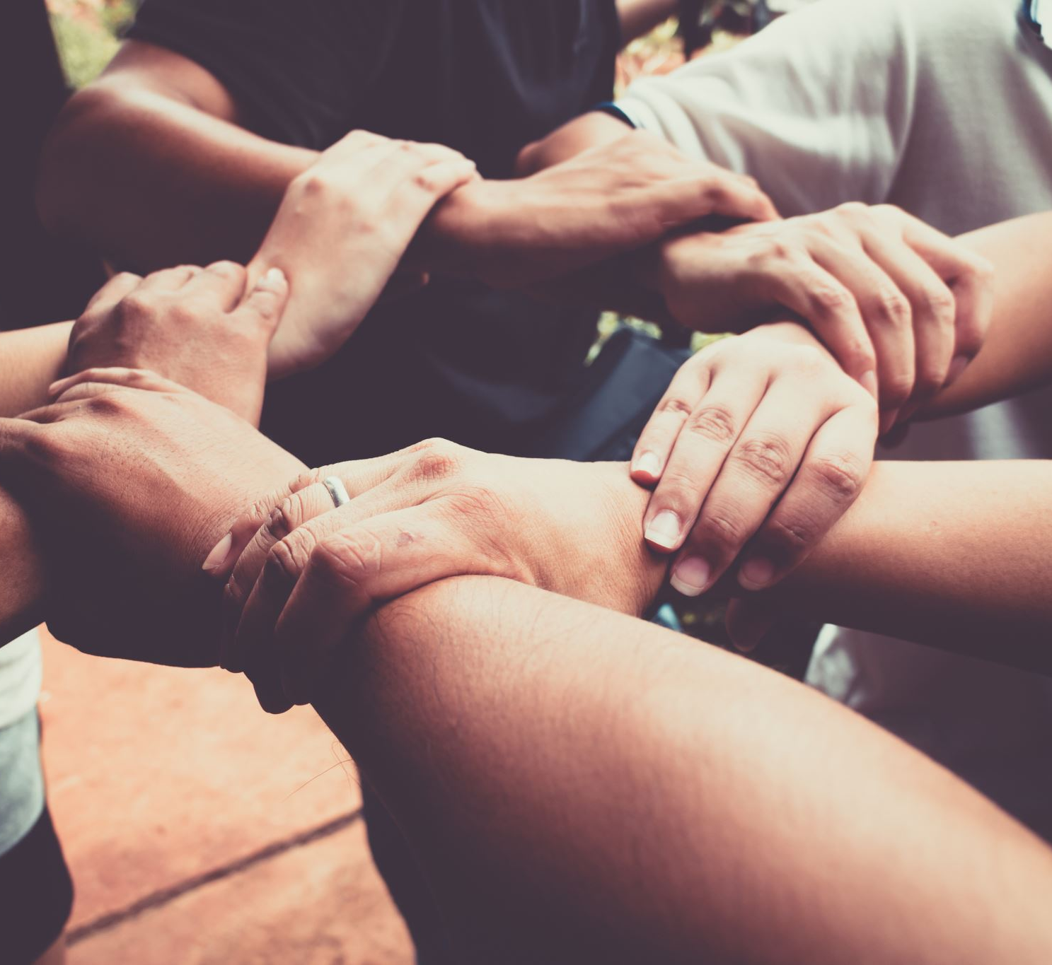
Meet the Dietetic team: Prescribing Support - YouTube

Slide 11

Education
Dietitians work as lecturers in higher education, helping to train student dietitians
They also work to train other health care workers such as nurses and GPs and to help the general public make informed choices about the food they eat

Slide 12
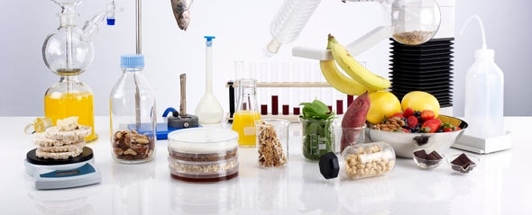
Research
Some dietitians work within research full time or some do it as part of their daily job
Dietitians are often interested in research in order to:
  Initiate and evaluate new ways of working in the field of nutrition and dietetics
  Evaluate and improve treatment
  Make use of new technology
  Keep other health care professionals informed and up to date
  Can work in higher education, research institutes, hospitals, medical schools and industrial environments

Slide 13

Freelance
Means to be ‘self-employed’ but still registered with HCPC and have BDA membership
Work in a range of areas:
Media
Advising the food and pharmaceutical industry
In private practice
Publishing

Slide 14
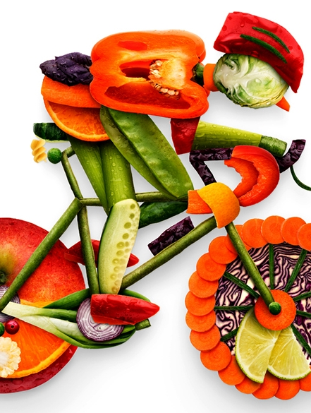
Sports Nutrition
Sports Dietitians provide expert advice on all areas of nutrition for sport
Help athletes to understand that what, when and how much they eat and drink can have an effect on their performance
Work alongside:
  Squads, teams and coaches
  Local fitness centres
  Provide advice to those catering for sports people
  Give advice on nutritional supplements

Slide 15
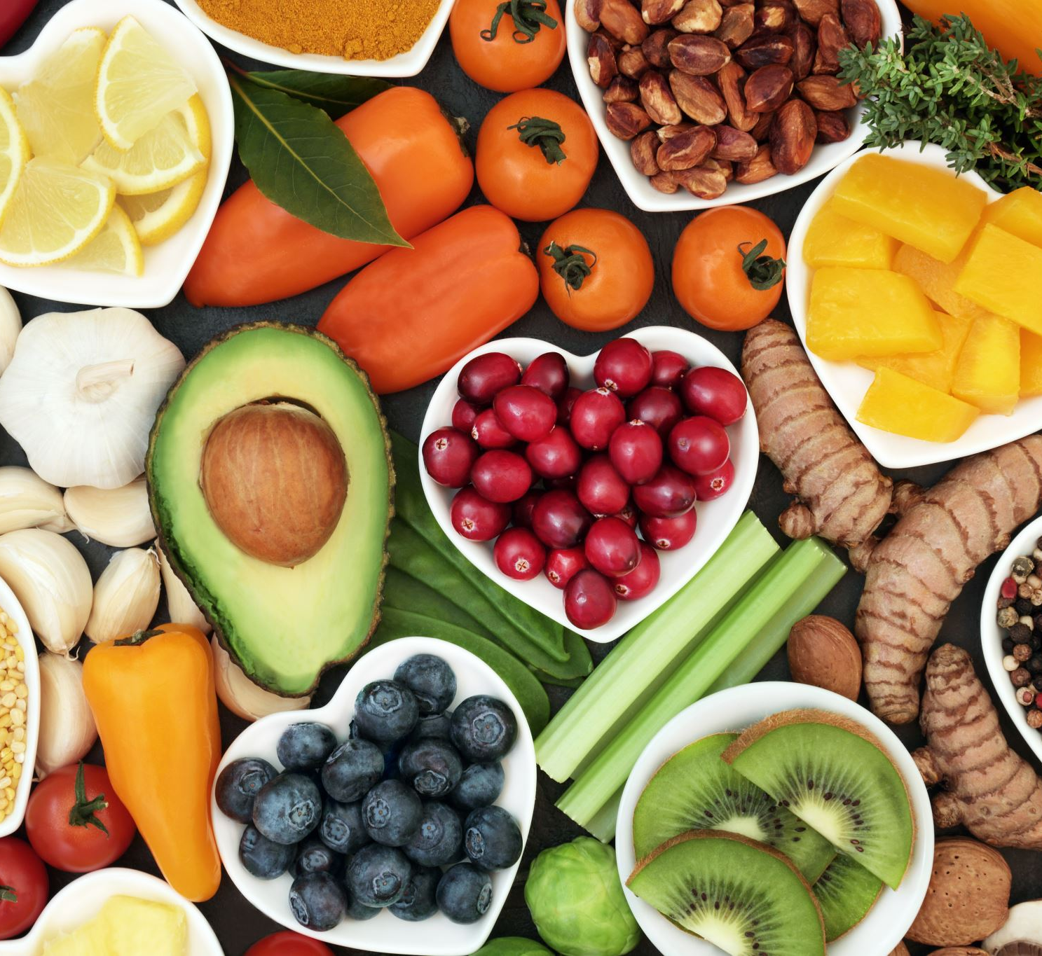
Food and
Pharmaceutical Industry
Many dietitians work directly for a food manufacturer, food retailer
Some may work for a pharmaceutical company e.g. selling nutritional products
May work with a public relations company representing an industry client
Give unbiased advice on nutrition, produce nutritional literature, respond to customer concerns and set nutritional standards for companies

Slide 16

Media
With the growing public interest in diet and health many dietitians work in media to ensure consistent and accurate messages are delivered
Writing articles for local and national newspapers and magazines
Appearing on popular TV or radio programmes

Slide 17

Skills & Qualities Are Required To
Be A Dietitian
Communication (verbal/written)
Listening
Organisation
Observational
Motivational
Caring/understanding attitude
IT
Teamwork
Independent
Dependable

Slide 18
Further Information / Reference`s
British Dietetic Association
  Professional Body Representing Dietitians in the UK
  www.bda.uk.com
Health and Care Professionals Council
  www.hpc-uk.org/

